Slide 1


Module 3 – Managing Data Sources

Slide 2
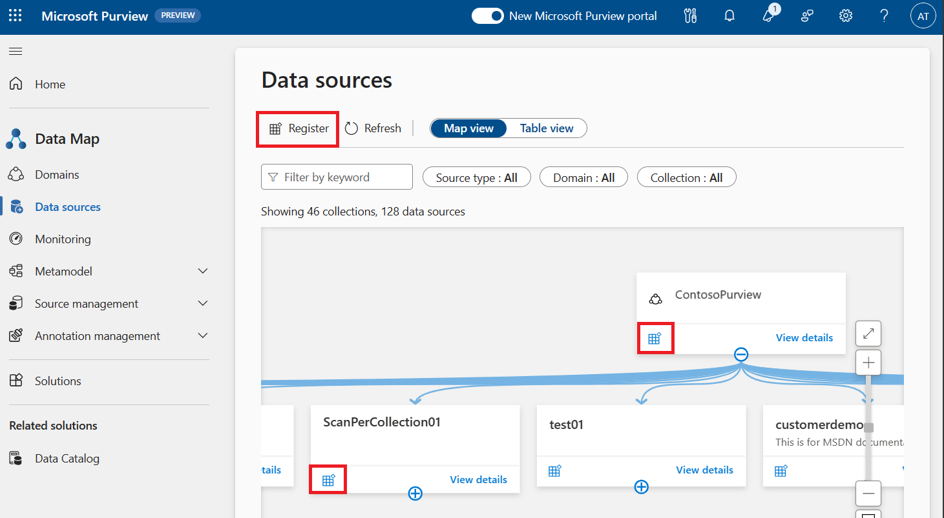
Registering Data Sources
Every source has it's own prerequisites and information for registration and scanning. For detailed registration and scanning steps for any source, see the detailed page for that source.
2

Slide 3
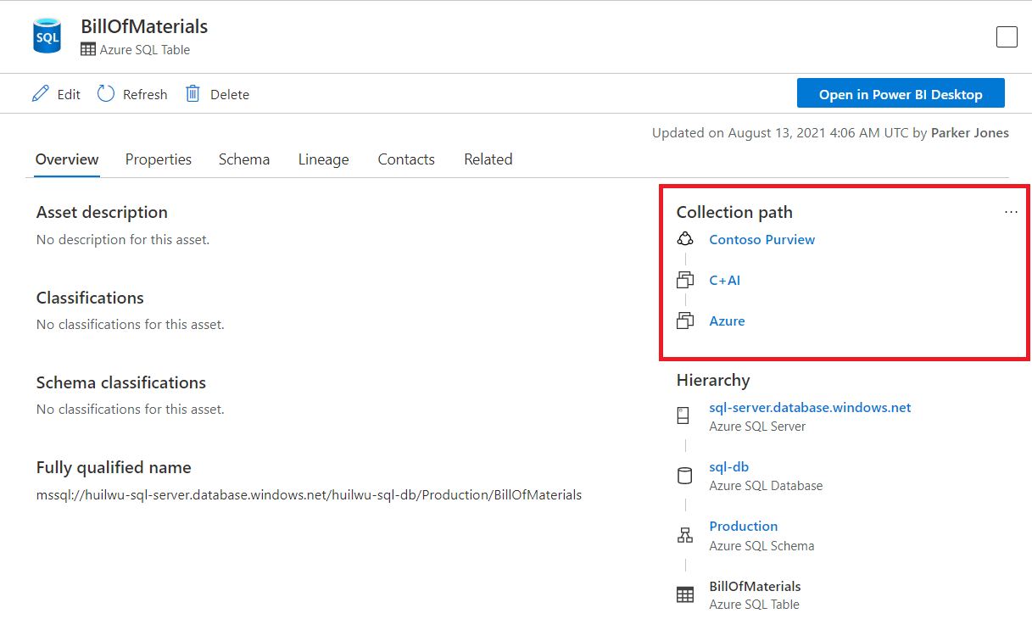
Managing Data Sources
Assets and sources are also associated with domains and collections. During a scan, if the scan was associated with a domain or collection, the assets will be automatically added to that resource, but the assets can also be manually moved to any subcollections (if you have the write permissions on those subcollections.)
3

Slide 4
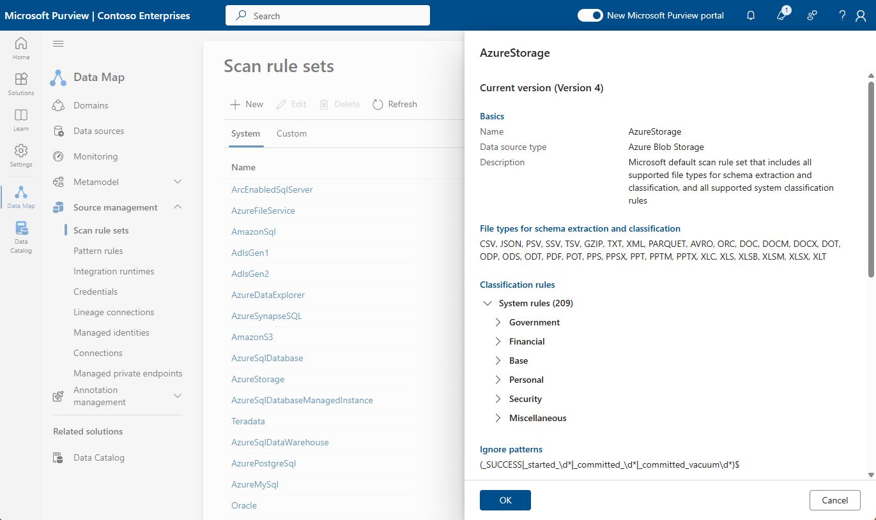
Understanding Scan Rule sets
Default Scan Rule set for each data source type
Create custom rule sets to better suit your organization's needs
Notes:
Microsoft Purview comes with a default Scan Rule set for each data source type. These rule sets are designed to scan the most common file types and metadata. Each scan ingests the metadata and applies a series of classifications to the dataset. Out of the box, there are over 200+ classifications that can be applied, ranging from Government issued IDs (Australian Passport Number, US Social Security Number...), Financial, Personal, Security... to custom classifications that you can define based on the shape of your data.
The default rule set for each data source is a good starting point, but you may want to create custom rule sets to better suit your organization's needs as you learn about your data. For example, you may want to exclude certain file types from a scan or you may want to apply a specific classification to a certain type of data.
As scans consume compute resources, it's important to ensure that your rule sets are optimized to scan only the data that is necessary and only apply the classifications you expect. This will help to improve the performance of your scans. In a practical sense, there is no point analyzing the data source to detect Argentina National Identity (DNI) Number if you know for a fact that your data source does not contain information of this type.
✨ Pro Tip: You can only use the scan rule set in the domain where you created it.

Slide 5
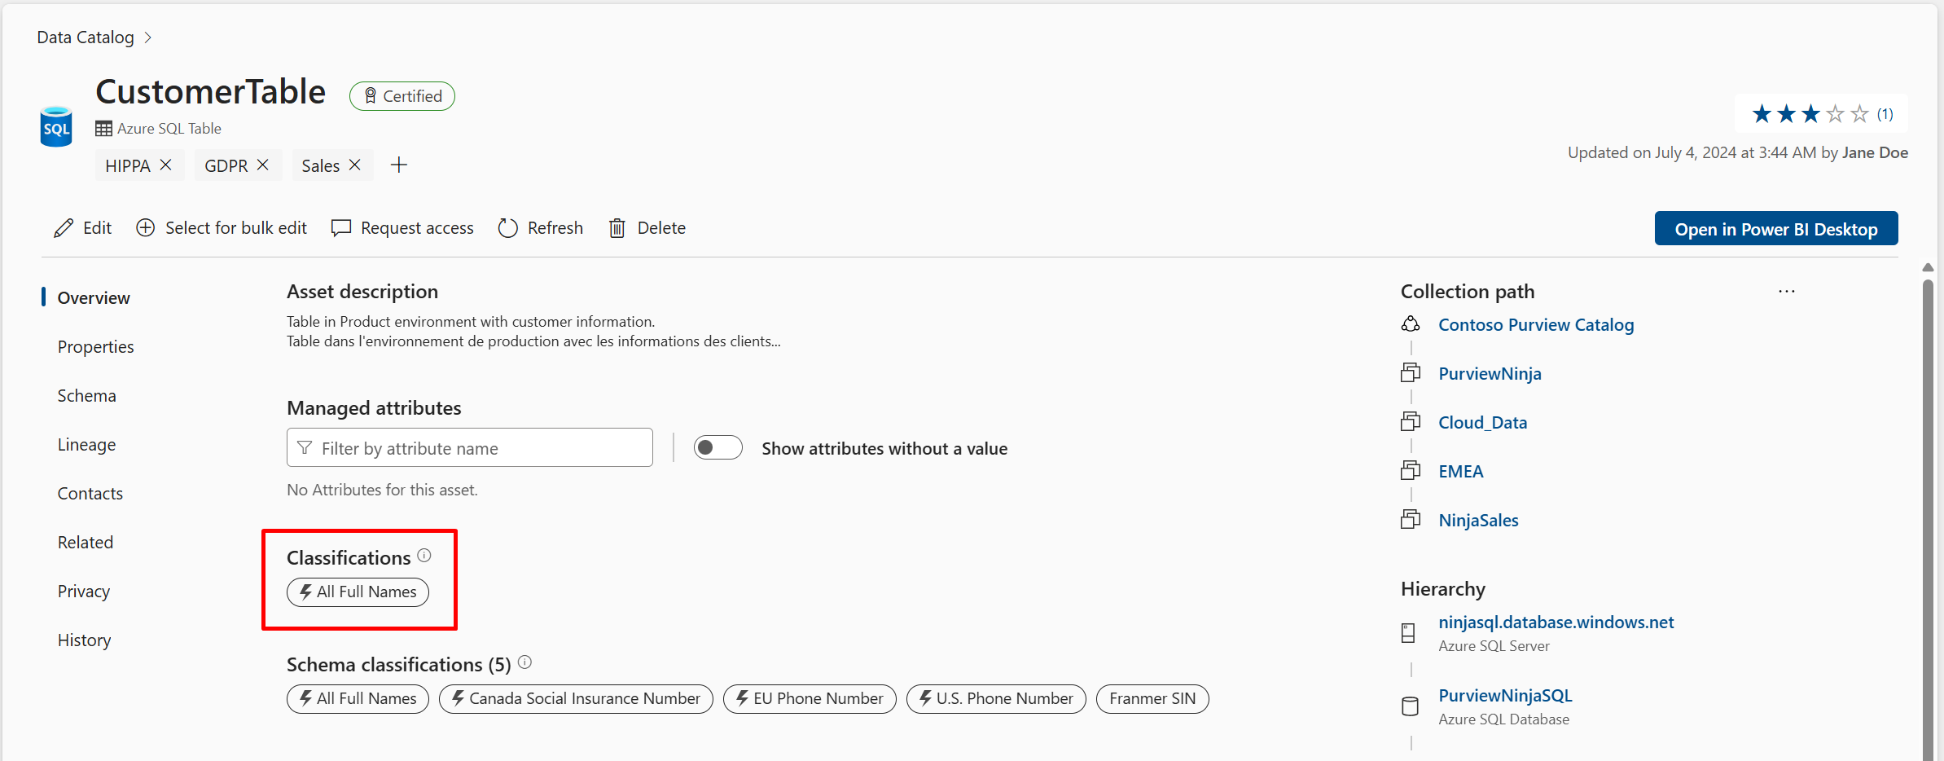
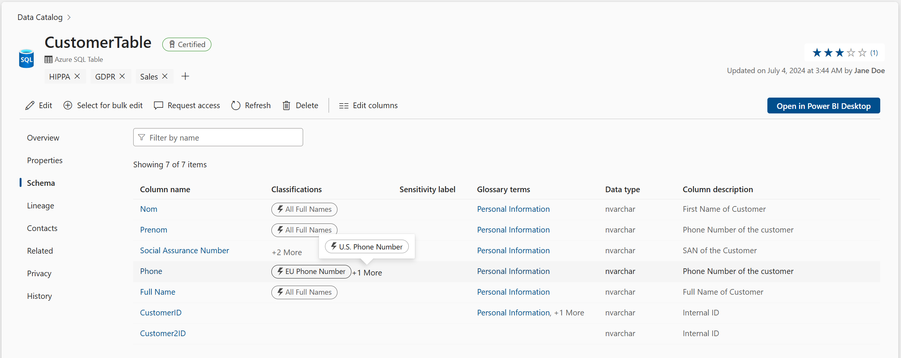
Understanding Classifications
Classifications are applied at the time of scanning. Purview Data Governance comes with several international system classifications
Example: How asset-level classifications appear for an Azure SQL Table
Example: How schema-level classifications appear for an Azure SQL Table
Custom Classifications
regular expression patterns or dictionary lookups
percentage of sampled rows that must match
Notes:
Classifications are applied at the time of scanning and are used to categorize and label data assets. Purview Data Governance comes with several international system classifications that are scanned for by default, but you can also create custom classifications to more accurately detect and tag data throughout your organization.
Custom Classifications
If a bespoke classification does not exist out of the box, you may decide to create a "custom" classification. These may either be regular expression patterns or dictionary lookups. You also define the percentage of sampled rows that must match the regular expression or dictionary lookup to apply the classification. The lower percentage, the higher the hit-rate and increased risk of false positives.
An example of a custom classification would be a specifically formatted Invoice ID (e.g. INV-123-XYZ) which comes from a specific source system, or an X (formerly Twitter) handle (e.g. @username).

Slide 6
Understanding Integration Runtimes
Team Activity: Review the integration runtimes available in Purview and discuss which runtimes are best suited to your organization's needs.
Azure Integration Runtime
Managed Virtual Network (VNet) Integration Runtime
Self-hosted Integration Runtime
Kubernetes supported Self-Hosted Integration Runtime
This runtime is managed by Azure and is used to connect to Azure data sources. It is auto-resolved by Azure and does not require any additional configuration.
This runtime is used to connect to data sources in a virtual network. It is auto-resolved by Azure and does not require any additional configuration.
This runtime is hosted on your organization's network and is used to connect to on-premises data sources. It requires additional configuration to connect to your data source.
This runtime is used to connect to on-premises data sources. It requires additional configuration to connect to your data source.
AWS Integration Runtime: This runtime is used to connect to AWS data sources
Notes:
Purview uses integration runtimes (IR) to connect to data sources and provide the compute to run the scans. Not all data sources support all integration runtime types and vice a versa.
These runtimes can be auto-resolved by Azure or self-hosted (SHIR) by your organization. The choice of integration runtime depends on the data source you are connecting to and the network configuration of your organization.
You can choose between:
Azure Integration Runtime: This runtime is managed by Azure and is used to connect to Azure data sources. It is auto-resolved by Azure and does not require any additional configuration.
Managed Virtual Network (VNet) Integration Runtime: This runtime is used to connect to data sources in a virtual network. It is auto-resolved by Azure and does not require any additional configuration.
Self-hosted Integration Runtime: This runtime is hosted on your organization's network and is used to connect to on-premises data sources. It requires additional configuration to connect to your data source.
Kubernetes supported Self-Hosted Integration Runtime (Preview): This runtime is used to connect to on-premises data sources. It requires additional configuration to connect to your data source.
AWS Integration Runtime: This runtime is used to connect to AWS data sources.
✨ Pro Tip: When choosing an integration runtime, consider the network configuration of your organization and the data source you are connecting to. If you are connecting to an on-premises data source, you must use a self-hosted integration runtime.

Slide 7
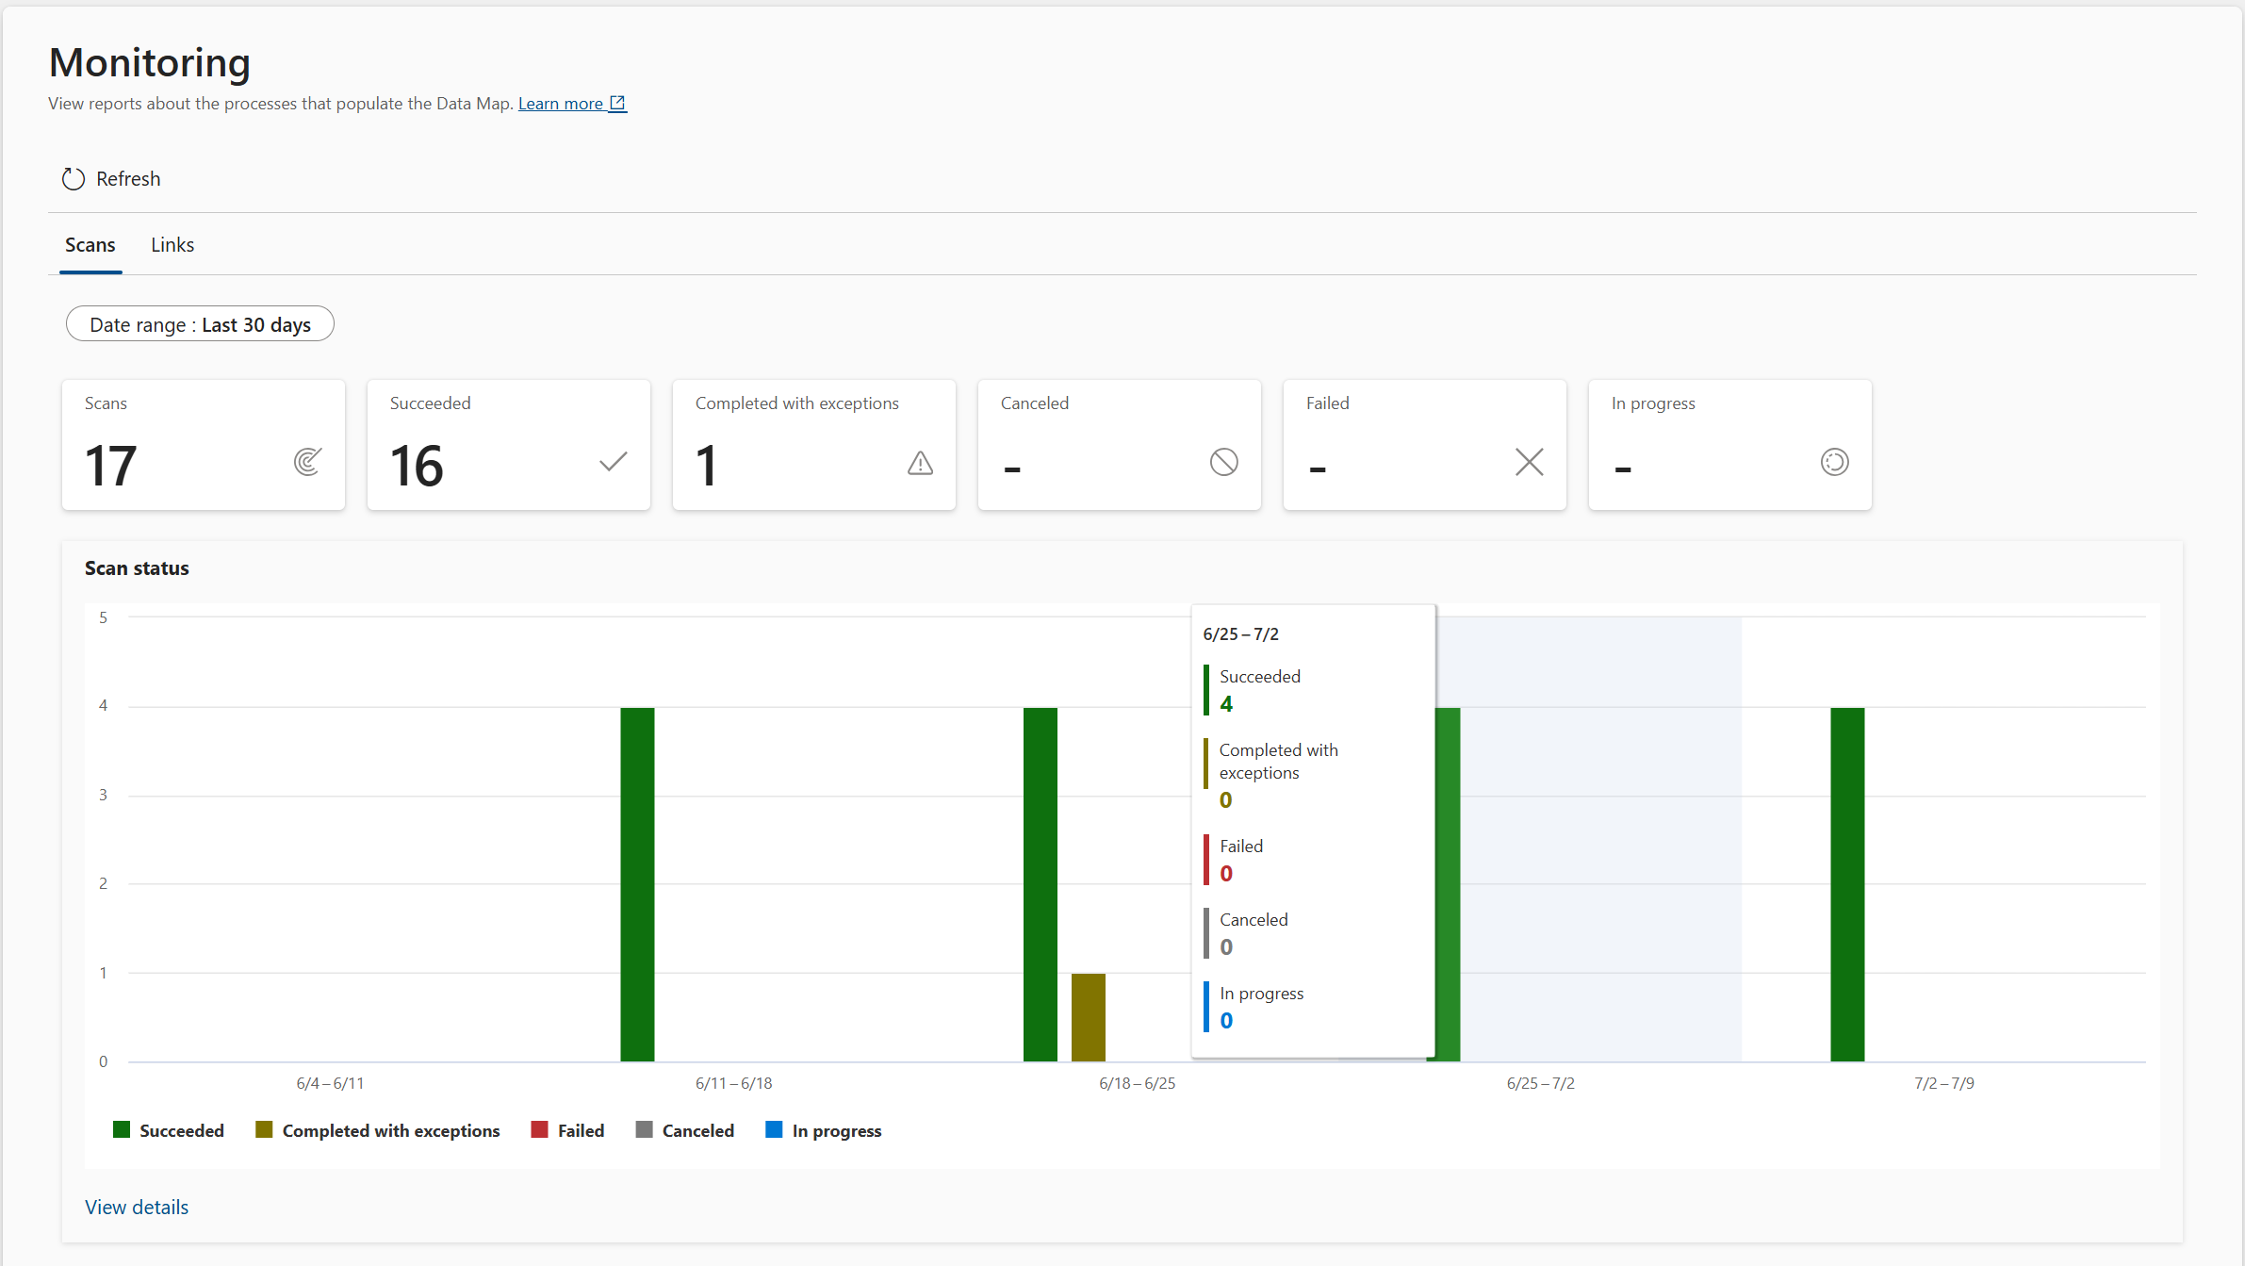
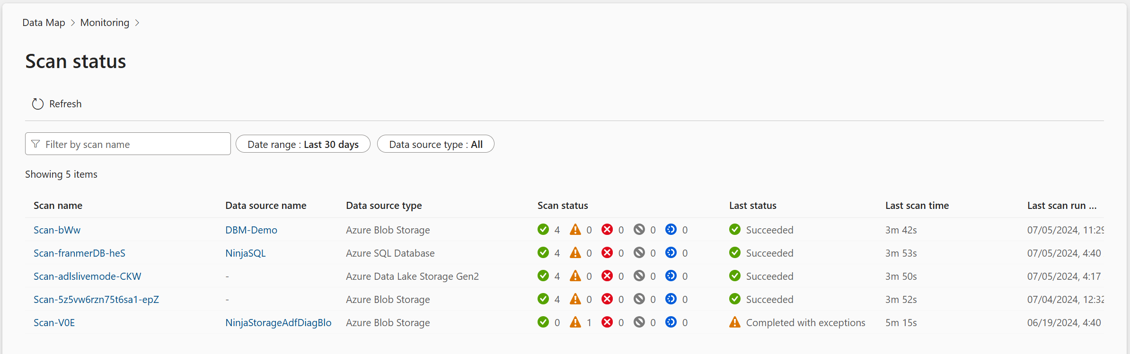
Monitoring
Exercise: Monitor your data source scans
Do in Purview: Spend a few minutes familiarizing yourself with the types of scan statuses and logs available in the Monitoring tab of the Data Map solution.
Did your data source scan from Task 2 complete successfully? If not, can you find out why?
Notes:
Each scan you configure in Microsoft Purview Data Governance has an associated Run ID, which uniquely identifies it. You can view an all-up scan status via the Data Map's Monitoring tab and drill deeper into each category to discover more details.
More Details:
Additional information (including logs) is available.

Slide 8
Module 3
Lab Time

